Slide 1
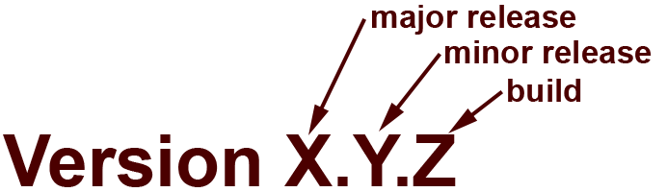
Version Control Systems
Farzad Khodadadi
Melbourne eResearch Group
University of Melbourne
Farzad.khodadadi@unimelb.edu.au
Notes:
The University of Melbourne
MELBOURNE RESEARCH
www.research.unimelb.edu.au

Slide 2
Outline
Versioning systems and their features
How code versioning works
Code versioning terminology
Git in a nutshell
Demo
Notes:
-How many are familiar with relaitonal algebra: Normal forms, Candidate keys, relations ?
- How many are familiar with OLAP, Data Warehousing, Fct table, Dimensions, Hierrachies ?

Slide 3
Versioning Systems
-What?
  Version control = Revision control = Source control
  Managing changes to documents, computer programs, large web sites, and other collections of information
  Revision numbers: letters or numbers used to represent each change
-Why?
  Work simultaneously on big projects and keep track of changes
  Be able to simply revert back to a specific checkpoint/milestone in any project
  Create necessary redundancy by duplicating codes and resources to avoid data loss
Notes:
-How many are familiar with relaitonal algebra: Normal forms, Candidate keys, relations ?
- How many are familiar with OLAP, Data Warehousing, Fct table, Dimensions, Hierrachies ?

Slide 4
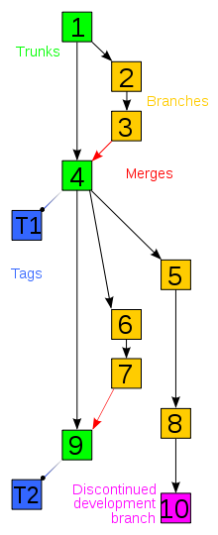
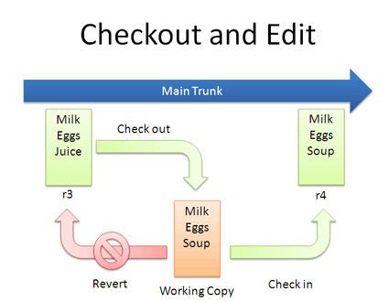
Versioning Systems
-How?
Notes:
-How many are familiar with relaitonal algebra: Normal forms, Candidate keys, relations ?
- How many are familiar with OLAP, Data Warehousing, Fct table, Dimensions, Hierrachies ?

Slide 5
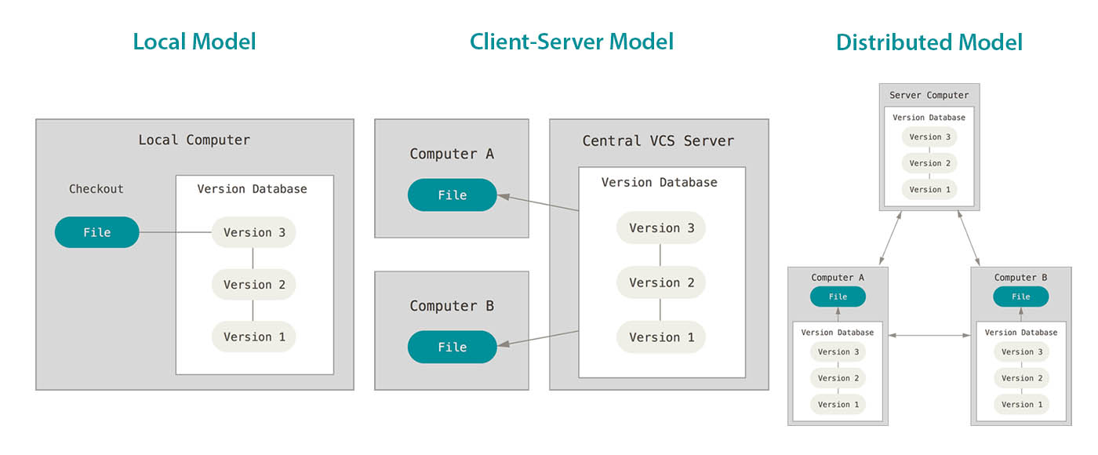
Version Control Systems
-Types
  -Local (Revision Control System (RCS))
  -Centralised (Concurrent Versions System (CVS), Subversion (SVN), Vesta)
  -Decentralised (Git, Mercurial, Bitbucket )
Notes:
-How many are familiar with relaitonal algebra: Normal forms, Candidate keys, relations ?
- How many are familiar with OLAP, Data Warehousing, Fct table, Dimensions, Hierrachies ?

Slide 6
Code Versioning Terminology
Branch: A set of files under version control may be branched or forked at a point in time so that, from that time forward, two copies of those files may develop at different speeds or in different ways independently of each other.
  Trunk: The unique line of development that is not a branch (sometimes also called Baseline, Mainline or Master)
Pull, push: Copy revisions from one repository into another. Pull is initiated by the receiving repository, while push is initiated by the source. Fetch is sometimes used as a synonym for pull, or to mean a pull followed by an update.
Merge: A merge or integration is an operation in which two sets of changes are applied to a file or set of files.
Commit: To commit (check in, ci or, more rarely, install, submit or record) is to write or merge the changes made in the working copy back to the repository.
Clone: Cloning means creating a repository containing the revisions from another repository. This is equivalent to pushing or pulling into an empty (newly initialized) repository.
Checkout: To check out (or co) is to create a local working copy from the repository. A user may specify a specific revision or obtain the latest.
Tag: A tag or label refers to an important snapshot in time, consistent across many files.
Notes:
-How many are familiar with relaitonal algebra: Normal forms, Candidate keys, relations ?
- How many are familiar with OLAP, Data Warehousing, Fct table, Dimensions, Hierrachies ?

Slide 7




Created by Linus Torvalds and the team working on Linux kernel development in 2005
Distributed revision control system
Repositories can be published via HTTPS, FTP, rsync, or a Git protocol over either a plain socket, or SSH
Git servers
  Github: A website that offers repository hosting service where you can upload a copy of your Git repository
  Bitbucket: A web-based hosting service for projects that use either Git or Mercurial revision control systems
  GitLab
Notes:
-How many are familiar with relaitonal algebra: Normal forms, Candidate keys, relations ?
- How many are familiar with OLAP, Data Warehousing, Fct table, Dimensions, Hierrachies ?

Slide 8


Git: Installation
macOS
    $ brew update
    $ brew install git
Linux (Ubuntu)
    $ sudo apt-get update
    $ sudo apt-get install git
Windows (Git client, WSL, Git GUI client …)
  is your best friend ;p
  Not sure how? Click here.
  Powered by
Notes:
The University of Melbourne
MELBOURNE RESEARCH
www.research.unimelb.edu.au

Slide 9
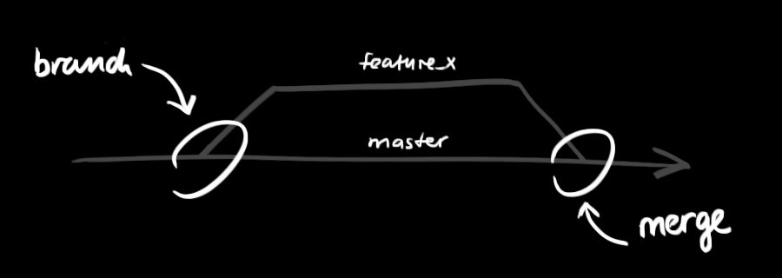
Git: a simple guide
Branching
  Diverge from the main line of development and do work without messing with the main line
  Main branch: e.g. master
  Development branch: e.g. develop
  Other branches:
    Feature branch: add a new feature, e.g. feature/add-a-new-feature
    Bugfix branch: fix a bug, e.g. bugfix/fix-a-bug
    Release branch: make a release, e.g. release/1.0
    Hotfix branch: hotfix a bug in a release, e.g. hotfix/fix-another-bug
Notes:
The University of Melbourne
MELBOURNE RESEARCH
www.research.unimelb.edu.au

Slide 10
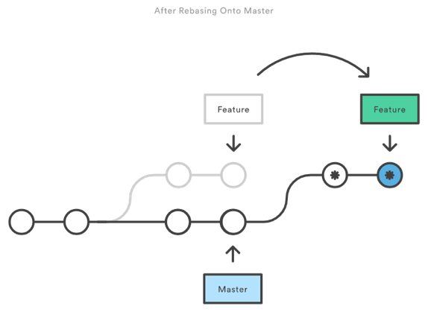
Rebase
Notes:
The University of Melbourne
MELBOURNE RESEARCH
www.research.unimelb.edu.au

Slide 11
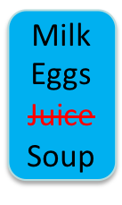
Git at a glance
0.1.0
0.1.1
0.1.2
Milk
Eggs
Juice
Milk
Eggs
Soup
Milk
Eggs
Soup
Apple
Main Branch (master)
0.1.0
Milk
Eggs
Juice
Commit
Milk
Eggs
Soup
Merge
Rebase
Merge
Checkout
Push
Revert
feature/1 (local)
feature/1 (local)
feature/1 (remote)
0.1.0
Milk
Eggs
Juice
Milk
Eggs
Juice
Apple
Milk
Eggs
Juice
Apple
Milk
Eggs
Soup
Apple
Checkout
Commit
Push
feature/2 (local)
feature/2 (local)
feature/2 (remote)
Notes:
The University of Melbourne
MELBOURNE RESEARCH
www.research.unimelb.edu.au

Slide 12
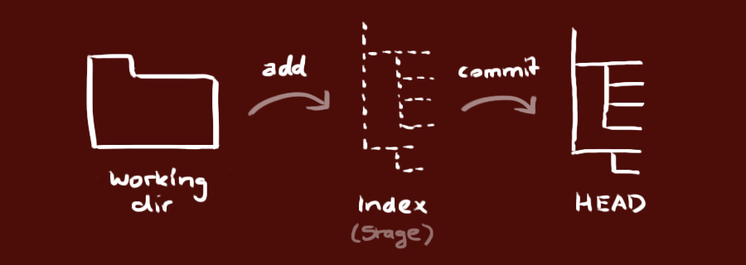
Git: a simple guide
Simple Workflow
  Made changes
  Add
    $ git add <filename>
  Commit
    $ git commit -m “commit message”
  Push
    $ git push origin feature/demo-1
    $ git push --set-upstream origin feature/demo-1
Notes:
The University of Melbourne
MELBOURNE RESEARCH
www.research.unimelb.edu.au

Slide 13
Git: a simple guide
Register an account on Bitbucket, Github or Gitlab
  Bitbucket - https://bitbucket.org
  Github - https://github.com/
  Gitlab - https://gitlab.com
Create a git repository (Local)
  Create a new directory
  $ git init
Create a git repository (Bitbucket)
Checkout a new repository
  $ git clone https://<username>@<hostname>/path/to/repo.git
Notes:
The University of Melbourne
MELBOURNE RESEARCH
www.research.unimelb.edu.au

Slide 14
Git: a simple guide
Branching
  Create a develop branch (from GUI)
  Create two feature branches
    $ git checkout -b feature/demo-1
    $ git checkout -b feature/demo-1-1
  Switch between branches
    $ git checkout feature/demo-1
  List all branches
    $ git branch
  Delete a branch
    $ git branch -d feature/demo-1-1
  Push a local branch to remote
    $ git push origin feature/demo-1
Notes:
The University of Melbourne
MELBOURNE RESEARCH
www.research.unimelb.edu.au

Slide 15
Git: a simple guide
Pull Request (Merge Request) – Code review
  Create Pull Request for others to review your code
  Approve or Decline a Pull Request
  Merge a Pull Request when all reviewers approved
Fetch and pull the changes from remote
  Fetch updates
    $ git fetch -a
  Pull changes from remote
    $ git pull
Notes:
The University of Melbourne
MELBOURNE RESEARCH
www.research.unimelb.edu.au

Slide 16
Git: a simple guide
Conflicts
  Conflict may happen if users changed the same code block
  Code cannot be merged until conflicts are resolved
  Scenario
    User A checked out develop branch and changed one line in README.md on feature branch feature/demo-2
    At the same time User B checked out develop branch and changed the same line in README.md on feature branch feature/demo-3
    User A merged the change to develop branch
    User B created a Pull Request to merge feature/demo-3 to develop branch and saw conflict
Notes:
The University of Melbourne
MELBOURNE RESEARCH
www.research.unimelb.edu.au

Slide 17
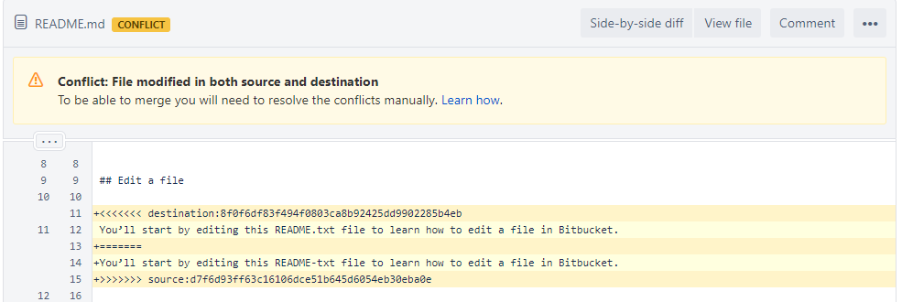
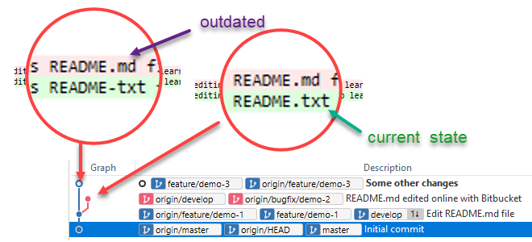
Git: a simple guide
Conflicts
Notes:
The University of Melbourne
MELBOURNE RESEARCH
www.research.unimelb.edu.au

Slide 18
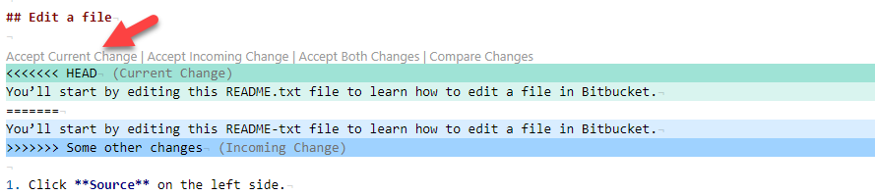
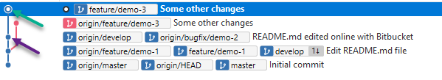
Git: a simple guide
Rebase and resolve the conflict (use tool)
  $ git fetch -a
  $ git pull --rebase origin develop
  $ git add READM.md
  $ git rebase --continue
Notes:
The University of Melbourne
MELBOURNE RESEARCH
www.research.unimelb.edu.au

Slide 19

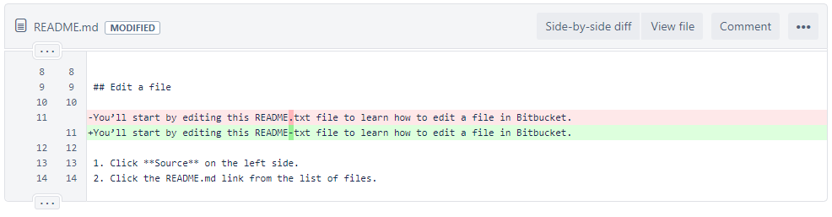
Git: a simple guide
Rebase and resolve the conflict (use tool)
  $ git push -f origin feature/demo-3
Notes:
The University of Melbourne
MELBOURNE RESEARCH
www.research.unimelb.edu.au

Slide 20


Slide 21
References
[1] https://en.wikipedia.org/wiki/Version_control
[2] https://git-scm.com/book/en/v2/Getting-Started-About-Version-Control
[3] http://rogerdudler.github.io/git-guide

